Slide 1
Project Presentation of CO-OP Project at Industry (Module-2) (22CS421)
On
Hyperlocal Real Estate Price Forecasting: A Case Study of the Noida Market Kavya Sharma
2210990500
Supervised By
Dr Gurpreet Singh (Associate Professor)
Department of Computer Science and Engineering,
Chitkara University, Punjab

Slide 2
Noida Market Variance
Challenge: Noida has a unique mix of Authority-developed plots and private high-rise societies.
Market Complexity: The Noida real estate ecosystem is highly fragmented, featuring a complex coexistence of Authority-developed independent plots and densely populated private high-rise housing societies.
The Valuation Gap: Standard property valuation models often fail here because they rely strictly on generic GPS coordinates or total carpet area. They completely ignore "hyperlocal" pricing dynamics and sector-specific premium values.
2

Slide 3
Methodology & Tech Stack
Algorithmic Approach: Implemented a Multiple Linear Regression (MLR) model to ensure high transparency and maintain interpretability for end-users, consciously avoiding "black-box" AI solutions.
Data Processing: Cleaned and normalized historical property dataset using Python and Pandas to remove outliers and handle missing variables.
Key Features Selected: Focused specifically on Sector Location, Carpet Area (sq. ft.), Total Bedrooms (BHK), and Proximity to the nearest Metro Station.
3

Slide 4
Key Results
Predictive Performance: The finalized regression model successfully achieved an 85.4% accuracy rate when validated against the 20% unseen testing dataset.
Feature Dominance: The statistical weights revealed a critical insight: 'Sector Location' and 'Metro Connectivity' are roughly 2.5x more influential in dictating the final property price compared to the physical square footage of the flat alone.
4

Slide 5
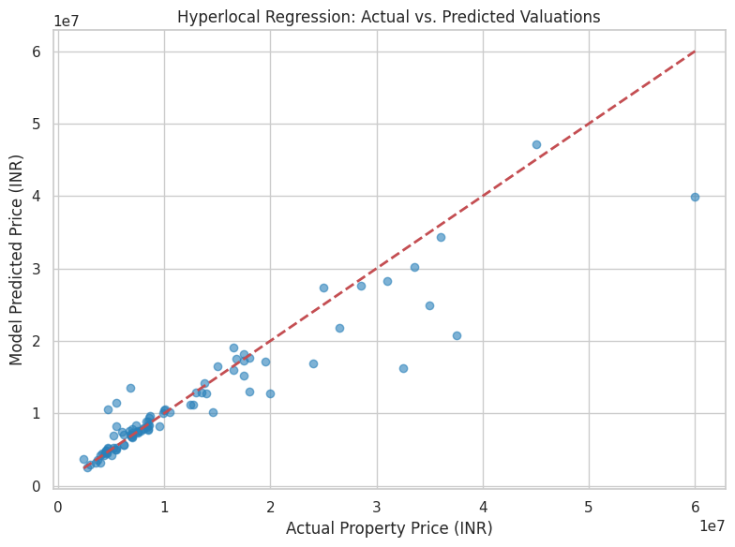
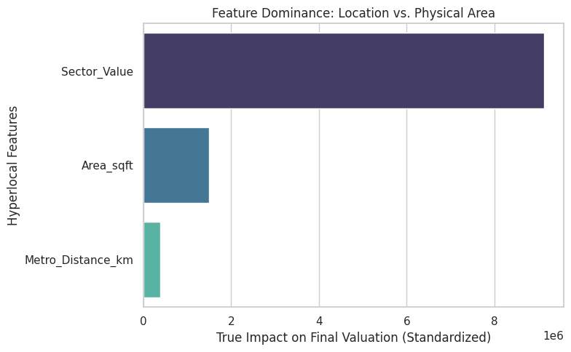
Graphs
5

Slide 6
Conclusion & Future Scope
Conclusion: This project successfully validates that transparent statistical models can achieve high predictive accuracy in complex, segmented markets when fed with engineered hyperlocal data.
It provides a practical, data-driven framework to minimize information asymmetry, helping buyers and sellers make fairer pricing decisions.
Future Scope: The current methodology can be significantly enhanced by integrating an automated web-scraping module to pull real-time property listings and prices.
Furthermore, the model can be scaled beyond Noida to encompass the entire National Capital Region (NCR) for broader market forecasting.
6

Slide 7
Thank You
7

